Slide 1

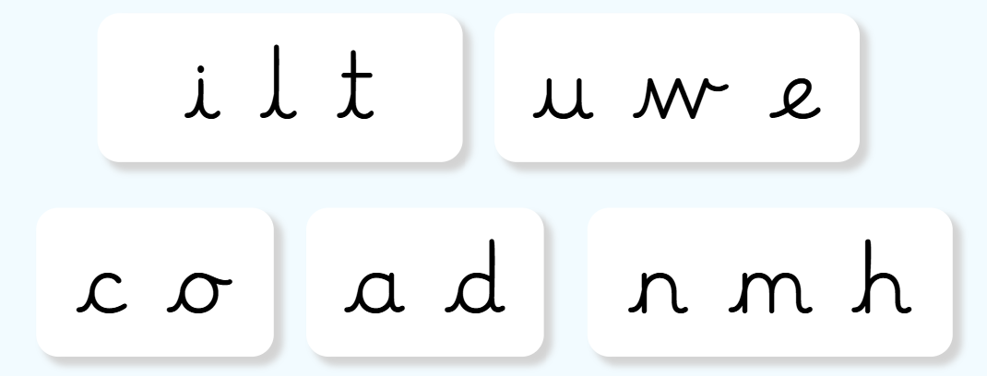
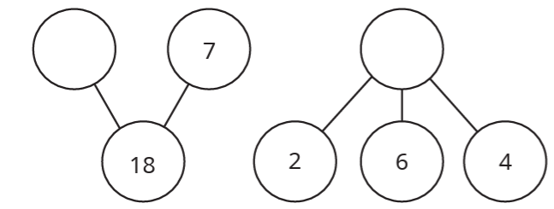
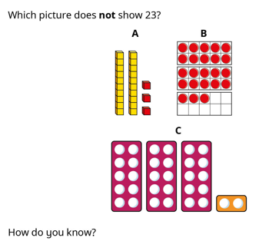
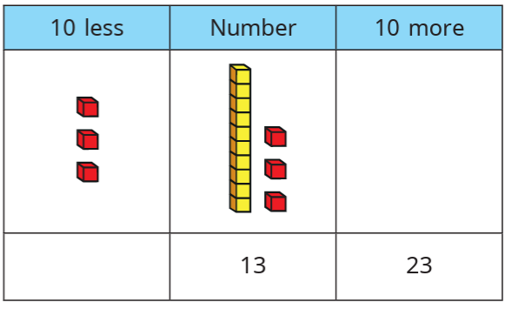
Year 3
Homework
Date Due: 13th October 2026
Last week – English
This week – English
Spot the mistakes and correct these factual sentences about the Stone Age.
the Stone Age was a period when humans make tools from stone People in the Stone Ages lived in cave and huts They hunted animals and gather plants for food Early human learning to make fire during the stone Age. The Stone Age end when people started using metal tool
Please practise letter formation. You can visit the letter join site to review how the letters should be formed.
eg.
As a challenge, use the letters to write words. See if you can include them in some silly sentences.
eg,. The little owl will dance.
Weekly Reading
Please read with your child at least 3 x per week, and write a comment in their reading record. The children may choose to read their school reading book or one that they have at home.
Touch-type
If time, you could practise touch-type using:
Computing KS2 - Dance Mat Typing - BBC Bitesize
Common Exception Words: are, so, full, were, by, house
Last week – Maths
This week – Maths
Extension: CPG Maths page 11
Challenge 1 – Are these numbers odd or even? How do you know?
eg. 43 is odd because it has 3 in the ones column. a) 63 b) 208 c) 87 d) 201 e) 74
Challenge 2 –
Challenge 1 – Complete the part-whole models.
Challenge 2 – Complete the table.
Weekly Times Tables
Please work with your child on recalling their times tables. You can you do this using Times Table Rockstars, the login is in your reading record.

